Slide 1
Distributed Systems
International Institute of Information Technology
Hyderabad, India
Pictures not cited explicitly are taken from the course book or wikepedia.

Slide 2
Course Policies
Textbook(s)
  Distributed Computing: Principles, Algorithms, and Systems, Kshemkalyani and Singhal.
  Others: Gerald Tel, Nancy Lynch
Grading policy
Class presentation, scribes: 10%
Project:20%
Assignments : 5 X 3 =15%
Quiz + sliptests 20%
MidSem, Endsem: (15+20)=35

Slide 3
TAs
Mayank Musaddi
Sanchit Saini (contact for presentations)
Mehul Gupta
Prazwal Chhabra
Pragun Saxena

Slide 4
Presentation format
Data Structures Week 1
6 mins for presentation.
Negative marking if time exceeded
4 mins for questions
Presenter can not take questions.
Scribes to contain brief summary of flow of topics, anything in particular of interest or questions discussed. Homeworks mentioned.
Two presentations per class. Topics and teams will be displayed a week earlier on the link on the website.

Slide 5
Syllabus (Tentative)
Module 1
  Introduction
  Time and Synchronization
  Mutual Exclusion
  Deadlock Detection
  Practice: RPC/gRPC/MPI/Map-Reduce
Module 2
  Distributed graph algorithms
  Consensus, Agreement, Locking
  Distributed File systems
  Practice: GFS, Chubby
  Distributed Database systems
  Practice: NoSQL, MongoDB

Slide 6
Definition
A group of computers working together as to appear as a single computer to the end-user.– Tannenbaum
A set of autonomous processes communicating among themselves to perform a task

Slide 7
Definition and Motivation
A group of computers working together as to appear as a single computer to the end-user.– Tannenbaum
Eg: Airline reservation, Online Banking
A set of autonomous processes communicating among themselves to perform a task
Required Features:
Lot of computers
Perform Concurrently
Fail independently
Dont share a global clock

Slide 8
Motivation
Challenges:
Unreliable network communication
Failure and recovery of nodes: You want correct amount in your account inspite of possible node failures.
Lack of global information/memory
Synchronisation (different systems have their own clocks)
Why Distributed Systems?
Best hardware may be insufficient to scale vertically (upgrade hardware of a system) hence the need to scale horizontally. Other benefits: Fault tolerance and low latency.
Notes:
Fault Tolerance: One machine stops working, you still get your queries answered
Low Latency: Can be designed to tap the closest machine for results

Slide 9
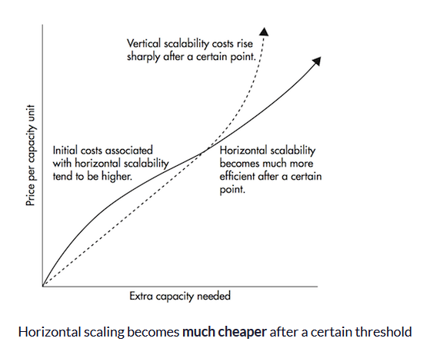
Data Structures Week 1

Slide 10
Data Structures Week 1
Motivation
Horizontal Scaling to fit data, shift data to manage load
Inherently distributed. Ex: Banking system across cities
Increased Performance/cost ratio (parallelistion)
Fault Tolerance

Slide 11
Data Structures Week 1
A Typical Setting
Multiple Computers together want to do a task
Data distributed across computers
Each computer makes decisions based on local data/computation and information received from other computers/sites.
Varities in models:
Topology: Ring, Tree, completely connected
Communication: Synchronous or unsynchronous
Synchronous communication happens when messages can only be exchanged in real time(in hand shake manner).
Asynchronous communication happens when information can be exchanged independent of time (eg: postal system –no handshake required).
Message Size (Limited based on channel bandwidth or theoretically unlimited)
Message Delivery Order: FIFO/Causal/Broadcast
Failure Models: Crash, Byzantine(malicious), Fail Stop…
And so on……

Slide 12
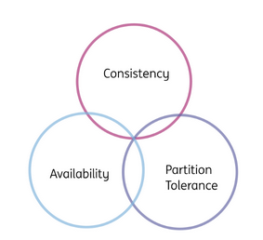
Data Structures Week 1
CAP Theorem- Eric Brewer (briefly)
The theorem states that a distributed data base system can only guarantee/strongly support two of the following three properties:
Partition Tolerant — A partition is a communications break within a distributed system—a lost or temporarily delayed connection between two nodes. Partition tolerance means that the cluster must continue to work despite any number of communication breakdowns between nodes in the system. The system continues to function in spite of network partitions.
Consistency — A guarantee that every node in a distributed cluster returns the same, most recent, successful write. Consistency refers to every client having the same view of the data.
Availability — Every non-failing node must be able to respond for all read and write requests in a reasonable amount of time.
Network partitions and dropped messages are a fact of life and must be handled forcing
designers to either choose perfect consistency or perfect availability.
Notes:
https://stackoverflow.com/questions/12346326/cap-theorem-availability-and-partition-tolerance

Slide 13
Data Structures Week 1
Complexity Analysis
Time complexity: Number of rounds of messages
Messange Complexity: Number of messages
Size of messages: Number of bits
Others…..

Slide 14
Data Structures Week 1
Time in Distributed Systems

Slide 15
Data Structures Week 1
Why is time important?
a) In a distributed banking system, if the timing and ordering of financial transactions are not tracked, it may raise inconsistent state in the system.
b) A distributed online reservation system in which the last available seat may get booked from multiple nodes if their local clocks are not synchronized.
c) There is a need to transmit a message from one node to another at any time. This will become difficult if sender and receiver clocks are not synchronized with each other.
More on time:
https://www.ripublication.com/acst17/acstv10n6_38.pdf

Slide 16
Why is time important
Data Structures Week 1
to determining the order in which events occur
helps maintain consistency in replicated databases,
helps design correct deadlock detection algorithms to avoid phantom and undetected deadlocks.
Tracking of dependent events
In debugging, it helps construct a consistent state
for resuming reexecution; in failure recovery, it helps build a checkpoint;
in replicated databases,
it aids in the detection of file inconsistencies in case of a network partitioning

Slide 17
Physical Time and Synchronization
In centralized systems, there is only single clock. A process gets the time by simply issuing a system call to the kernel.
  The time returned by the kernel is the “time”.
In distributed systems, there is no global clock or common memory. Each processor has its own internal clock and its own notion of time.
These clocks can easily drift seconds per day, accumulating significant errors over time.
This clearly poses serious problems to applications that depend on a synchronized notion of time.
Notes:
The rate of drift depends on the clock's quality, sometimes the stability of the power source, the ambient temperature, and other subtle environmental variables. Thus the same clock can have different drift rates at different occasions.
So constant update of time is required

Slide 18
Cristian’s (Time Server) Algorithm
Uses a time server to synchronize clocks
  Time server keeps the reference time (say UTC)
  A client asks the time server for time, the server responds with its current time, and the client uses the received value T to set its clock
But network round-trip time introduces errors…
  Let RTT = response-received-time – request-sent-time (measurable at client),
  If we know (a) min = minimum client-server one-way transmission time and (b) that the server timestamped the message at the last possible instant before sending it back
  Then, the actual time could be between [T+min,T+RTT— min]

Slide 19
Berkeley UNIX algorithm
One daemon without UTC
Periodically, this daemon polls and asks all the machines for their time
The machines respond.
The daemon computes an average time and then broadcasts this average time.
Notes:
The Berkeley algorithm is a method of clock synchronisation in distributed computing which assumes no machine has an accurate time source. It was developed by Gusella and Zatti at the University of California, Berkeley in 1989. Like Cristian's algorithm, it is intended for use within intranets.

Slide 20
Decentralized Averaging Algorithm
Each machine has a daemon without UTC
Periodically, at fixed agreed-upon times, each machine broadcasts its local time.
Each of them calculates the average time by averaging all the received local times.

Slide 21
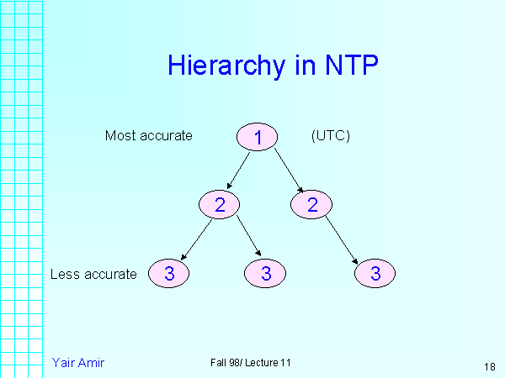
Network Time Protocol (NTP)
Most widely used physical clock synchronization protocol on the Internet
10-20 million NTP servers and clients in the Internet
Claimed Accuracy (Varies)
  milliseconds on WANs, submilliseconds on LANs
Hierarchical tree of time servers.
  The primary server at the root synchronizes with the UTC.
  Secondary servers - backup to primary server.
  Lowest
    synchronization subnet with clients.

Slide 22
Data Structures Week 1
However even with NTP, physical time cannot be perfectly synchronised. Moreover different nodes might have different NTP servers they are talking to as well.
But, do we really need to know the physical time or do we only need to know the sequence of events and that too among dependent events?

Slide 23
Modeling Distributed Systems
Can think of a distributed system as a collection of processors, and
A communication network.
The processors
  May fail
  Share no global memory
We also assume that the network
  Has delays that are finite but unpredictable.
  May not respect message ordering
  Can lose messages, duplicate messages
  May have links that become unavailable/may fail.

Slide 24
A Distributed Program
distributed program is
  A set of n processes, P₁, P₂, …, P_{n}, typically each running on a different processor.
  A set of channels C_{ij} that connects Processor i to Processor j.
The state of a process P_{i} includes
  The local memory of P_{i}
  Also depends on messages sent,
  The state of a channel C_{ij} includes
  The messages in transit on this channel.

Slide 25
Types of events
We will assume that processor sending a message does not wait for its delivery.
Any distributed program has three types of events
  Local actions
  Message Send
  Message Receive
Can then view a distributed program as a sequential execution of the above events.

Slide 26
Logical Time
Data Structures Week 1
Logical time provides a mechanism to define the causal order in which events occur at different processes. The ordering is based on the following:
Two events occurring at the same process happen in the order in which they are observed by the process.
If a message is sent from one process to another, the sending of the message happened before the receiving of the message.
If e occurred before e' and e' occurred before e" then e occurred before e".

Slide 27
Causality between events
Think of events happening at a process P_{i}.
One can order these events sequentially,
In other words, place a linear order on these events.
Let h_{i} = {e¹_{i}, e²_{i}, …}, be the events at process P_{i}.
A linear order H_{i} is a binary relation →_{i} on the events h_{i} such that e^{k}_{i} →_{i} e^{j}_{i} if and only if the event e^{k}_{i} occurs before the event e^{j}_{i} at Process Pi.
The dependencies captured by →_{i} are often called as causal dependencies among the events h_{i} at P_{i}.

Slide 28
Causality for msgs
What about events generated due to messages?
Consider a binary relation →_{msg} across messages exchanged.
Clearly, for any message m, send(m) →_{msg} recv(m).
These two relations →_{i} and →_{msg} allow us to view the execution of a distributed program
Do you think we can sequentially place all events of the distributed system?

Slide 29
Causality Definition
One can now view the execution of a distributed program as a collection of events.
Consider the set of events H = U_{i} h_{i}, where h_{i} is the events that occurred at process P_{i}.
Define a binary relation → expressing causality among pairs of events that possibly occur at different processes. → defined as:
e^{x}_{i} → e^{y}_{j} iff
{
i = j and x < y, or
e^{x}_{i} →_{msg} e^{y}_{j}, or
There exists e^{z}_{k} in H s.t. e^{x}_{i} → e^{z}_{k} and e^{z}_{k} → e^{y}_{j}

Slide 30
Logical vs. Physical Concurrency
Two events are logically concurrent if and only if the events do not causally affect each other. In other words, e_{i} || e_{j} ↔ Not(e_{i} → e_{j}) and Not(e_{j} → e_{i}).
Note that for logical concurrency of two events, the events may not occur at the same time.
On the other hand, we define that two events are physically concurrent iff the events occur at the same physical time.

Slide 31
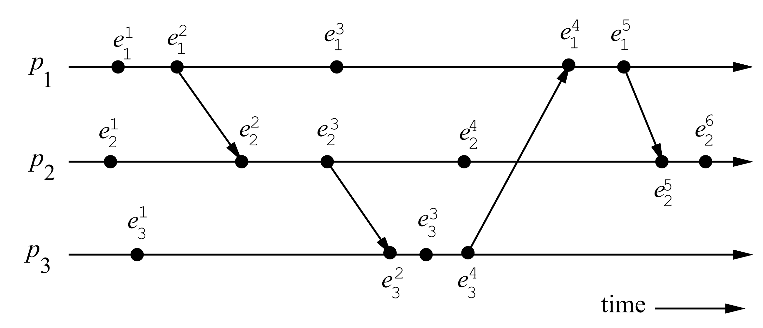
A Distributed Program in Execution
Examples – Find concurrent events, Find some non-trivial (across P_{i}s) precedence among events.

Slide 32
A Distributed Program in Execution
.
Concurrent: e¹₃ and e³₁ ? e⁴₂ and e¹_{3 ?}
Causal: e³₃ → e⁵₁, e²₁ → e³₂, e⁴₃ → e⁵_{1 ?}

Slide 33
A Distributed Program in Execution
.
_{If} eª_{j ||} e^{b}_{i and} e^{b}_{i ||} e^{c}_{k then} eª_{j ||} e^{c}_{k ?}

Slide 34
A Distributed Program in Execution
.
_{If} eª_{j ||} e^{b}_{i and} e^{b}_{i ||} e^{c}_{k then} eª_{j ||} e^{c}_{k ?}
_{Check} e³_{3 ||} e⁴_{2 and} e⁴_{2 ||} e⁵₁

Slide 35
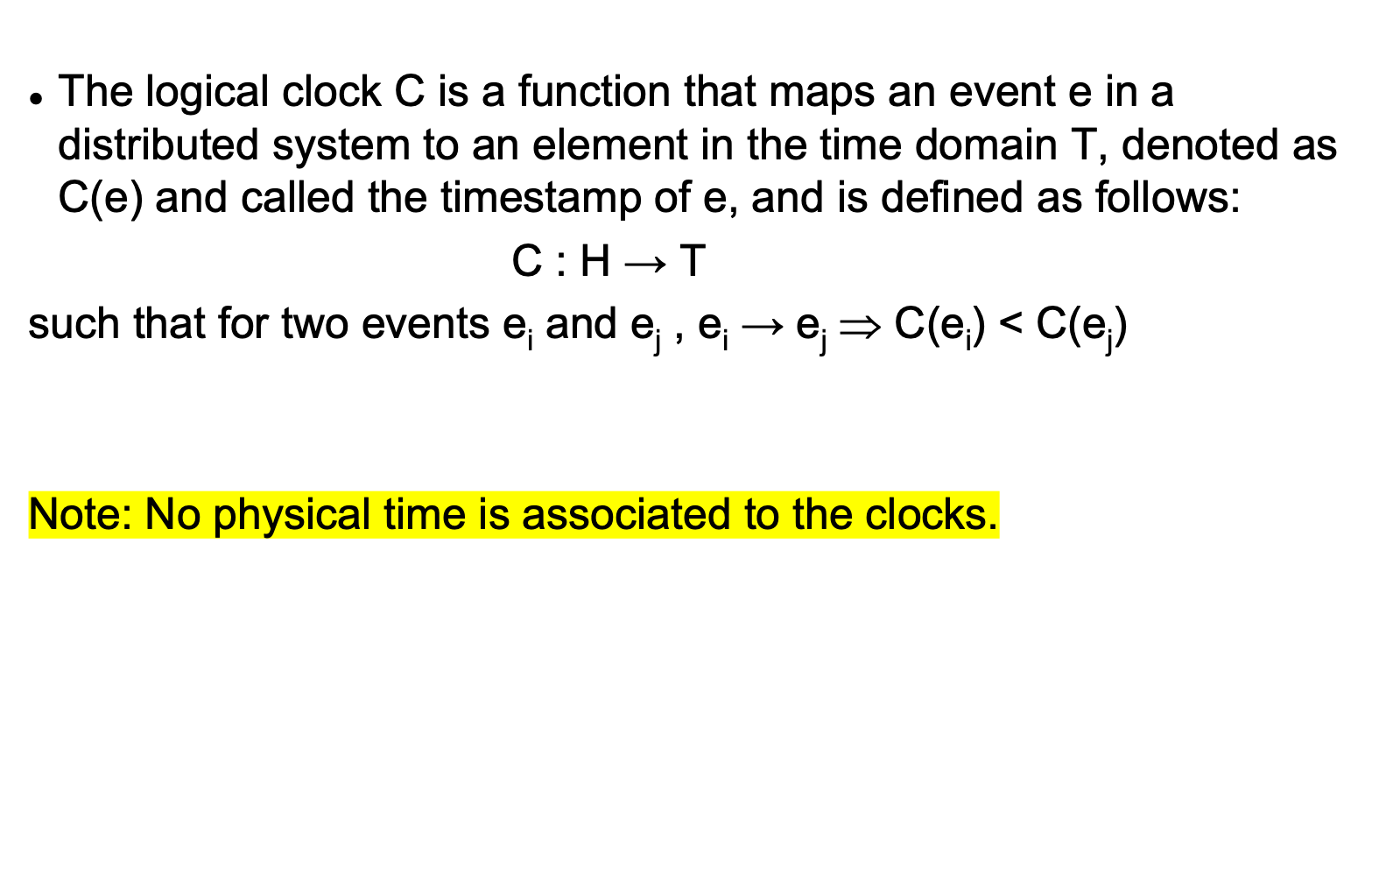
Logical Time
Data Structures Week 1

Slide 36
Logical Time
Data Structures Week 1
Consistent: When T and C satisfy the condition: for two events e_{i} and e_{j} , e_{i} → e_{j} ⇒ C(e_{i}) < C(e_{j}).
This monotonicity property is called the clock consistency condition.
Strongly Consistent: When T and C satisfy the condition:
for two events e_{i} and e_{j} , e_{i} → e_{j} ⇔ C(e_{i}) < C(e_{j}).
then the system of clocks is said to be strongly consistent.

Slide 37
Logical Time
Data Structures Week 1
Each processor needs some data structure to represent logical time.
  A local logical clock, denoted by lc_{i}, that helps process p_{i} measure its own progress.
  A logical global clock, denoted by gc_{i}, that is a representation of process p_{i}’s local view of the logical global time.
    Typically, lc_{i} is a part of gc_{i}.
Each processor needs a protocol to update the data structures to ensure the consistency condition.

Slide 38
Data Structures Week 1
Logical Time
Armed with our notation of events and precedences amongst events, we now study logical time.
We now see how logical time can be maintained in a distributed system.
Three ways to implement logical time -
  scalar time,
  vector time, and
  matrix time
scalar time,
vector time, and
matrix time

Slide 39
Scalar Time
Data Structures Week 1
Proposed by Lamport in 1978
  Lamport won the 2013 Turing award for “contributions to the theory and practice of distributed and concurrent systems, notably the invention of concepts such as causality and logical clocks, .....”.
Time domain is the set of non-negative integers.
The logical local clock of a process p_{i} and its local view of the global time are combined into one integer variable C_{i}.

Slide 40
Scalar Time
Data Structures Week 1
Data structure: The logical local clock of a process p_{i} and its local view of the global time are squashed into one integer variable C_{i}.
Rule1: Before executing an event (send, receive, or internal), process p_{i} executes the following:
C_{i} := C_{i} + d (d > 0)
  Rule 2: Each message piggybacks the clock value of its sender at sending time. When a process p_{i} receives a message with timestamp C_{msg} , it executes the following actions:
    C_{i} := max(C_{i}, C_{msg} )
    Execute Rule1.
    Deliver the message.

Slide 41
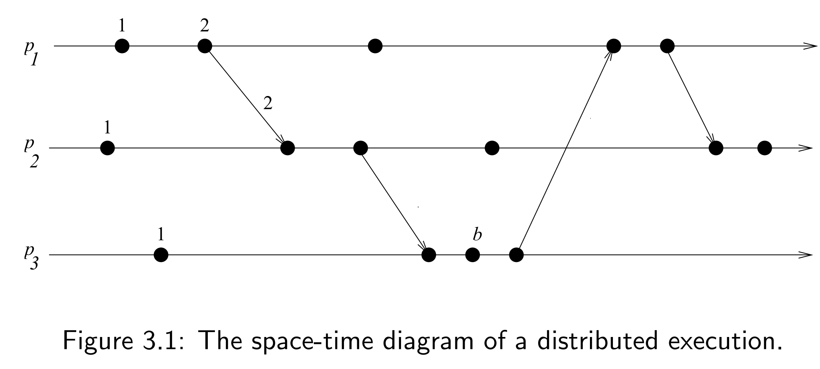
Scalar Time
Data Structures Week 1
Example. Use d = 1 and assign time stamps for the events.

Slide 42
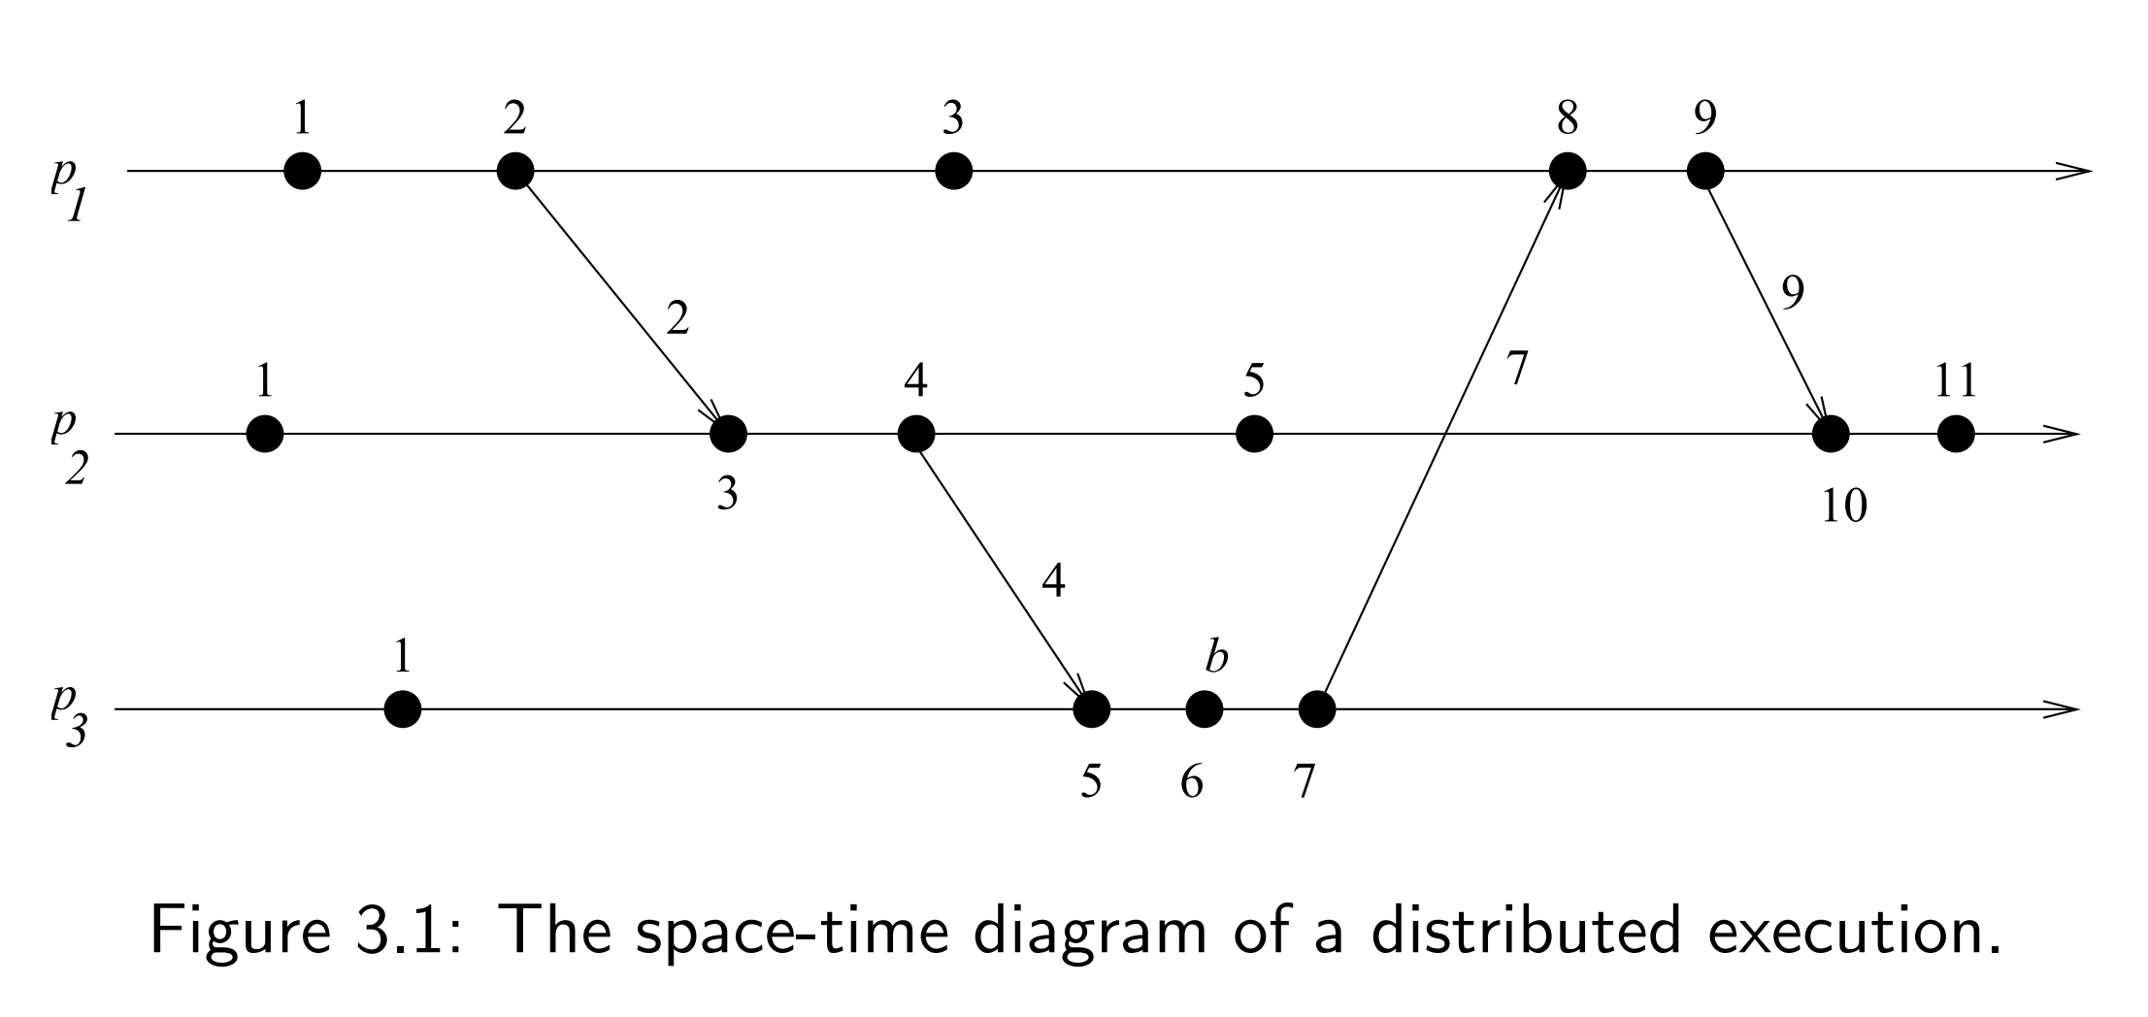
Scalar Time
Data Structures Week 1
Example

Slide 43
Scalar Time Properties
Data Structures Week 1
Monotonicity
  For two events e_{i} and e_{j} , e_{i} → e_{j} ⇒ C(e_{i}) < C(e_{j}).
Total Ordering: Can use the logical time given by the scalar clocks to induce a total order .
  Note that the timestamps alone do not induce a total order.
  Two events at different processors can have an identical timestamp.
  But the tuple (t, i) for each event with (t₁,i₁) < (t₂, i₂) if either t₁ < t₂ or ( (t₁ == t₂) and i₁<i₂) is a total order. In (t,i), t denotes timestamp and i the identiy of the process.
  This total order is consistent with the relation →.
  Note: According to the total order above: For events e1 and e2, e1 < e2 ⇒ Either e1 → e2 or e1 || e2.
Notes:
Little more on time: https://www.ics.uci.edu/~cs230/reading/time.pdf
Why total order is required: https://medium.com/coinmonks/time-and-clocks-and-ordering-of-events-in-a-distributed-system-cdd3f6075e73

Slide 44
Scalar Time
Data Structures Week 1
Event Counting: Set the increment d to 1 always.
If some event e has a timestamp t, then e is dependent on t – 1 other events to occur.
This can be called as the height of event e.
Does scalar time provide Strong Consistency ?
[Strong consistency requires that e_{i} → e_{j} ⇔ C(e_{i}) < C(e_{j}).]

Slide 45
Scalar Time
Data Structures Week 1
No Strong Consistency: Consider third event of p₁ and p₂.

Slide 46
Out of order messages
Data Structures Week 1
Suppose messages can be delivered out of order and I would like to deliver them in order. Can this be achieved when we don’t have strong consistency
Example say
First P1→a P3
Next P1 →c P2
Then, P2 →b P3
At P3, it is possible that b arrives before a (though a was sent before). When b arrives:
-P3 does not know whether a msg with lower timestamp might arrive
- Even if a arrives with lower timestamp after b, P3 can not know whether a actually happened before b (since time(a)< time(b) does not imply a->b as can also be a||b). Also P3 wont know if anything is yet to arrive either.
Will this problem be solved
with strong consistency?
Notes:
Here send of a happened causally before send of b. So at P3 we would like to order a before b on receipt but there is no way to figure out this information at P3 because C(a) < C(b) does not necessarily mean a happened b as scalar time does not have strong consistency. In vector clocks however, I can know that vector of send(a) lesser than send(b) and having strong consistency I can conclude that a was sent before b.

Slide 47
Data Structures Week 1
Out of order messages had two issues
In the absence of strong consistency, we can not be sure if one time stamp being lesser than the other necessarily means that one happened before the other
One wouldn’t know if a msg of lower time stamp is on the way and yet to arrive
HW : Will strong consistency resolve issue 1
Will strong consistent broadcast messages resolve issue 2 (This hw can be done after next class)

